Slide 1
Describing information influence in social media with coupling inference methods
Master in Computational Science and Engineering Mathematics Section, EPFL
SUPERVISORS
Dr. Erik Hemberg
Prof. Una-May O’Reilly
Prof. Robert West
STUDENT
Cyril Vallez
Master Thesis Defense
March 6th, 2023
Ecole Polytechnique Fédérale de Lausanne,
Massachusetts Institute of Technology

Slide 2
Introduction

Slide 3
Terminology
Falseness
Intent to harm
Misinformation
Sharing of false
or inaccurate information, regardless of intent to mislead
Disinformation
Targeted misinformation: intentional sharing of false or misleading information
Malinformation
Deliberate publication of private information

Slide 4
Circle of disinformation
Disinformation very frequent on social media.
Recommender systems help propagate it by maximizing user engagement.
Increasing number of people rely almost exclusively on social media for getting news.

Slide 5
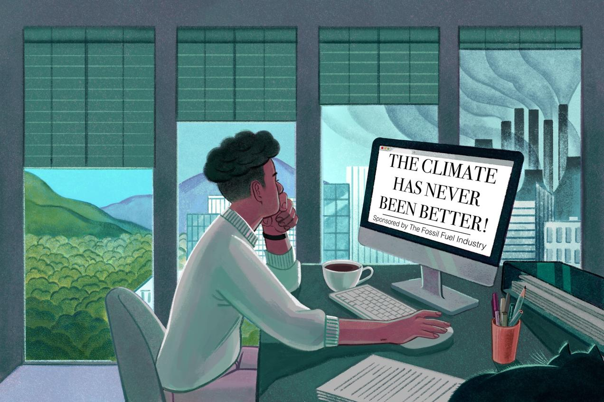
Impact of disinformation
Confused the public, led to political inaction, and to the rejection of mitigation policies
Lost of trust in government, scientific community, medicine...
Polarization and social fracture
Image from nrdc.org

Slide 6
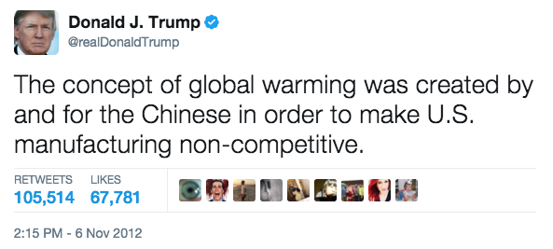
From Whom?
Individuals

Slide 7
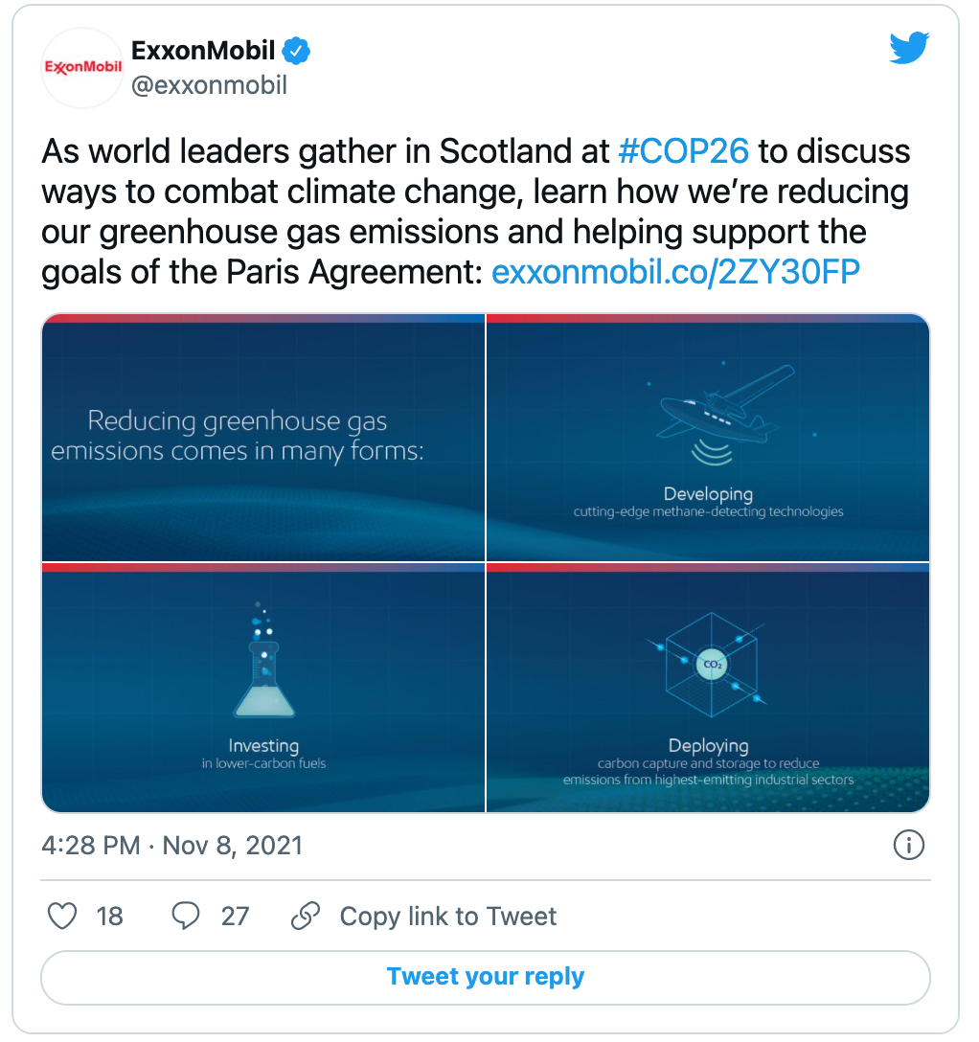
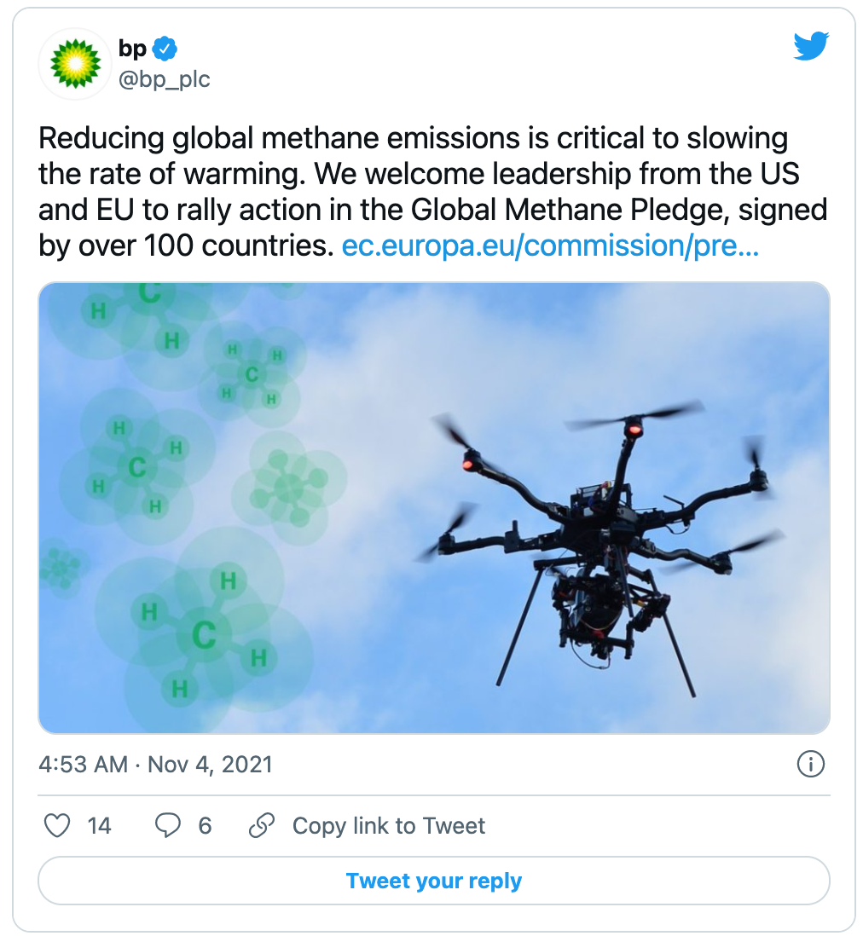
From Whom?
Individuals
Companies

Slide 8
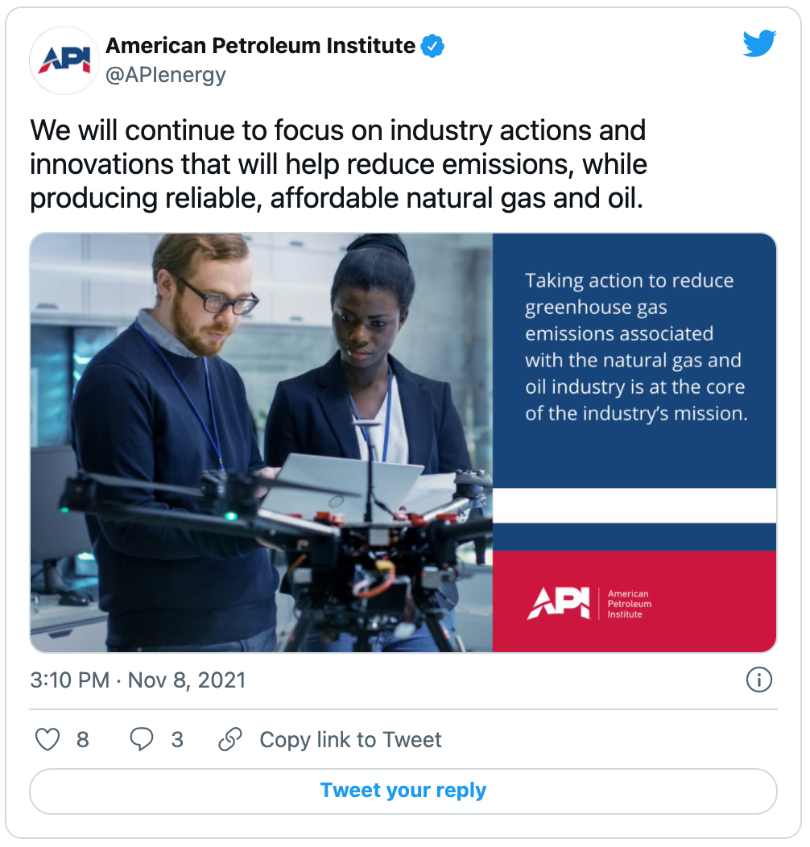
From Whom?
Individuals
Companies
Institutions

Slide 9
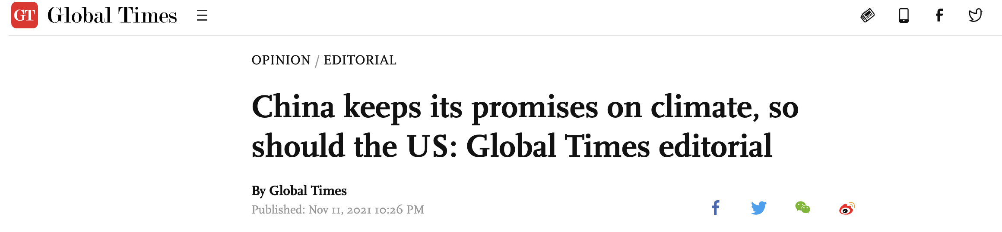
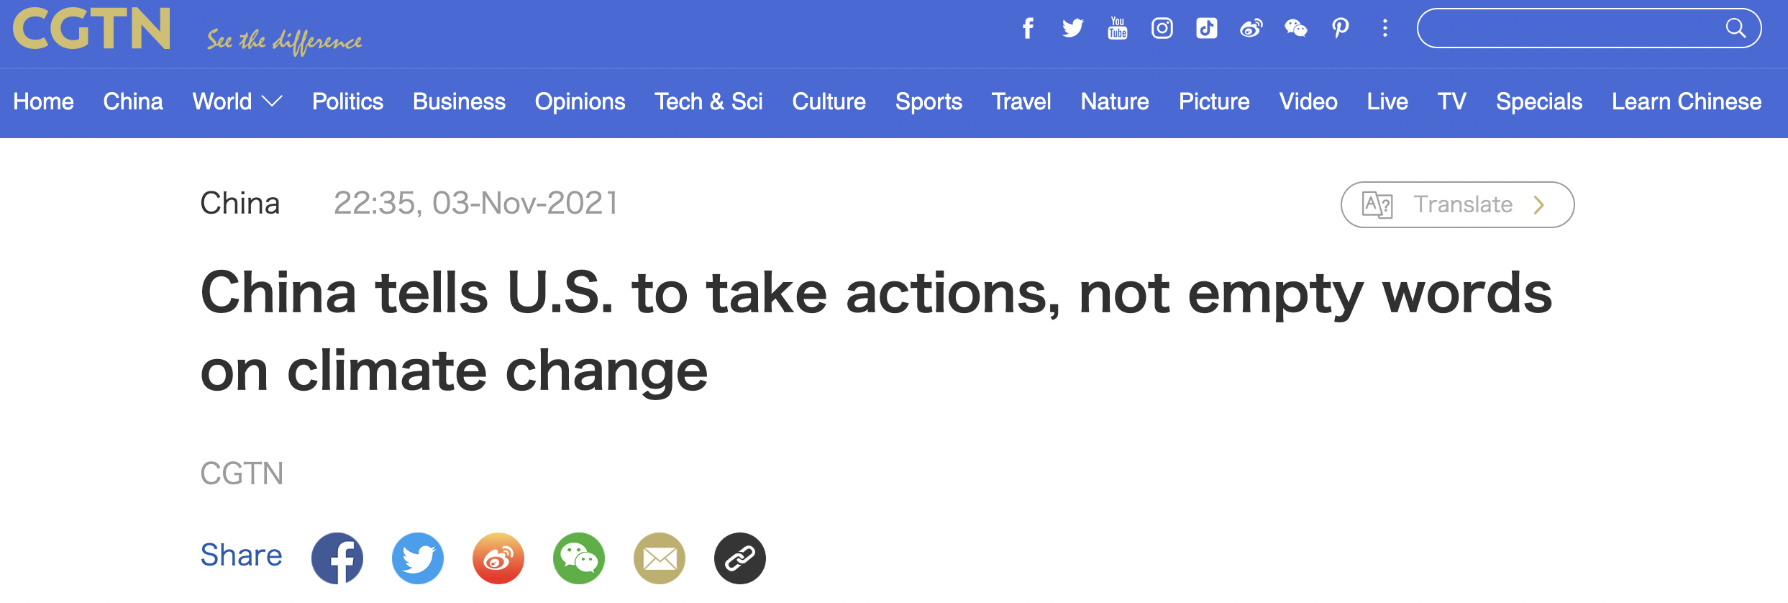
From Whom?
Individuals
Companies
Institutions
States
China-controlled media

Slide 10
Goal & Motivation

Slide 11
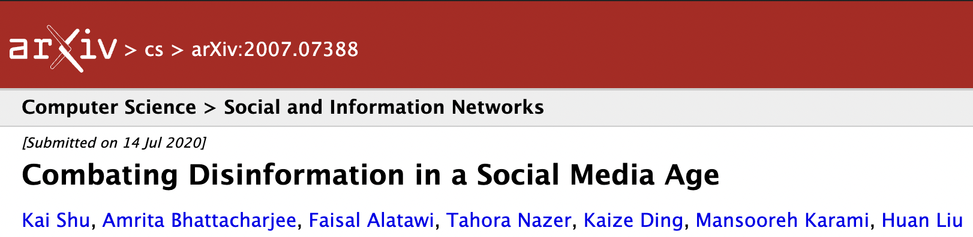
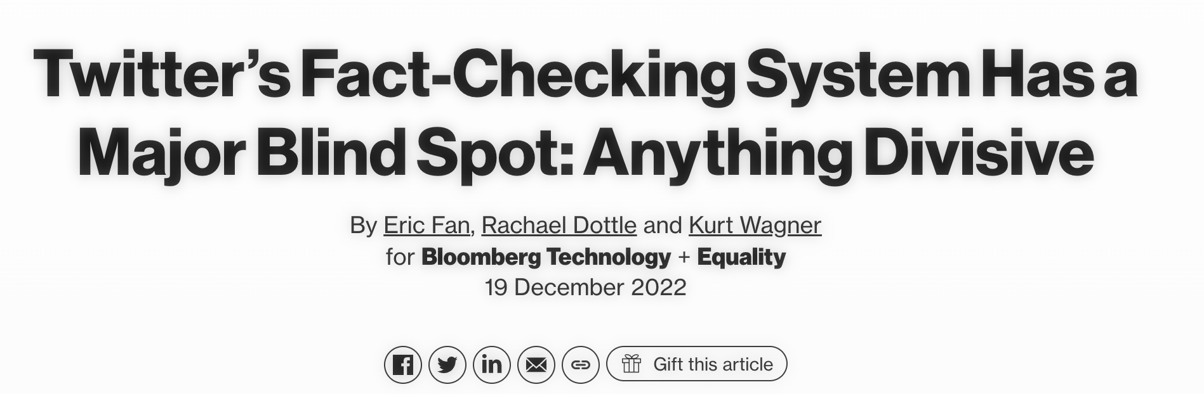
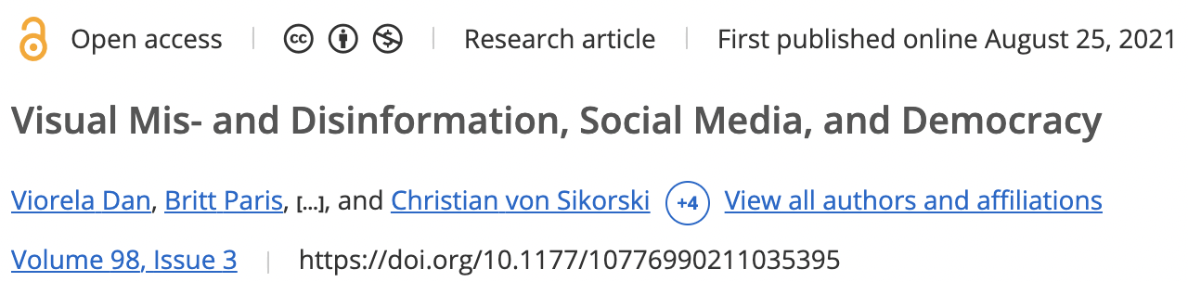
Detect and combat disinformation
Disinformation flows freely
Lot of research/efforts into developping new efficient tools to detect/prevent it
Impacts of disinformation campaigns are huge: social fracture, lost of trust

Slide 12
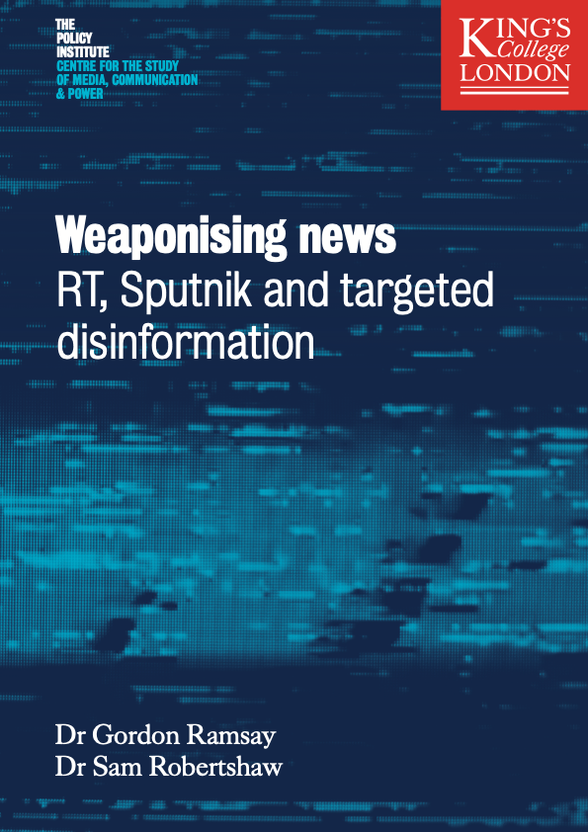

Disinformation campaigns
Large scale disinformation operation by coordinated actors
Quantifying influence between users on social media is difficult, but essential to detect and counter disinformation.

Slide 13
Disinformation campaigns
Large scale disinformation operation by coordinated actors
Quantifying influence between users on social media is difficult, but essential to detect and counter disinformation.
"To solve the climate crisis, we must also tackle the information crisis"

Slide 14
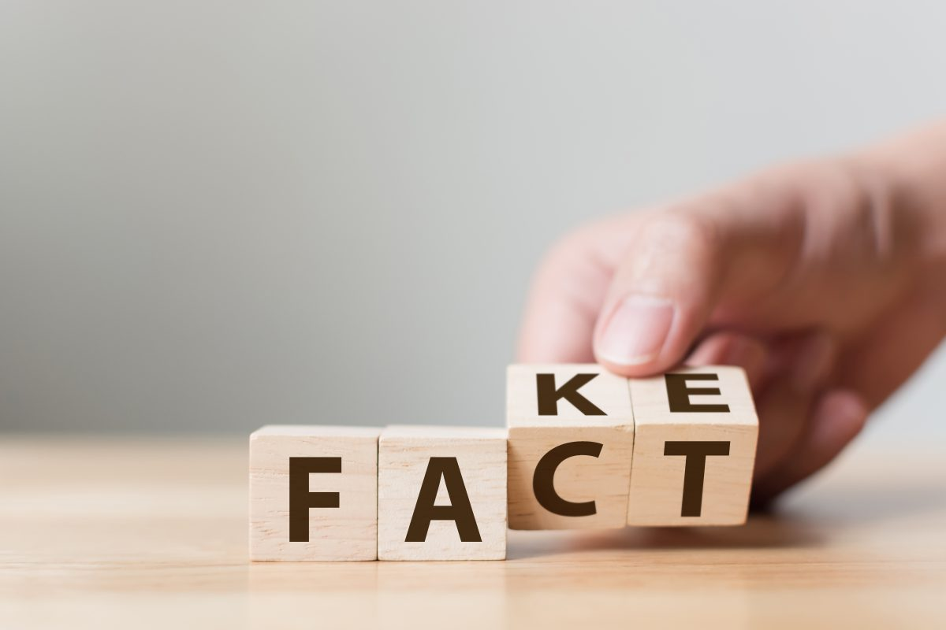
Modeling influence
Create a system able to capture influence attempts relating to (climate change) disinformation between users on Twitter.
Quantify the influence between users on Twitter
Derive new influence measures describing the amount of disinformation shared by the users on Twitter.
Image from commonexperience.edu

Slide 15
Contribution

Slide 16
Contribution
Create and curate 2 new datasets of tweets around COP26 and COP27

Slide 17
Contribution
Create and curate 2 new datasets of tweets around COP26 and COP27
Derive new influence measures

Slide 18
Contribution
Create and curate 2 new datasets of tweets around COP26 and COP27
Derive new influence measures
Study existing and new influence measures and how they are correlated

Slide 19
Contribution
Create and curate 2 new datasets of tweets around COP26 and COP27
Derive new influence measures
Study existing and new influence measures and how they are correlated
Sensitivity analysis of key-components of the framework

Slide 20
Contribution
Create and curate 2 new datasets of tweets around COP26 and COP27
Derive new influence measures
Study existing and new influence measures and how they are correlated
Sensitivity analysis of key-components of the framework
Generalize on different types of events

Slide 21
Methodology

Slide 22

Datasets
COP26: all climate-related tweets containing a URL around COP26 (2021).
COP27: all climate-related tweets containing a URL around COP27 (2022).
Control: all climate-related tweets containing a URL at random dates.
Skripal: all tweets related to the Skripal poisoning in 2018 and containing a URL.
Twitter API query to obtain climate-related tweets

Slide 23
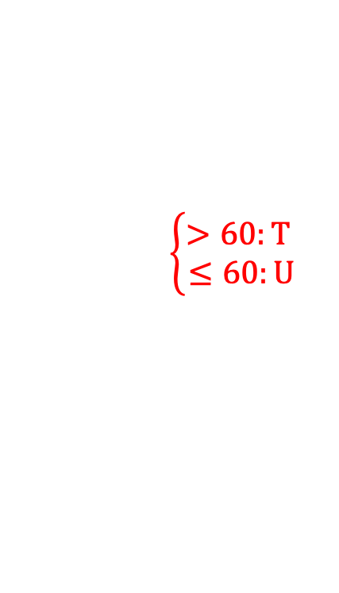
Data processing
NewsGuard ratings: 8145 unique news domains
Only tweets from users who posted at least 3 tweets
$$\left\{\begin{aligned}>60:T \\ ≤60:U\end{aligned}\right.$$

Slide 24
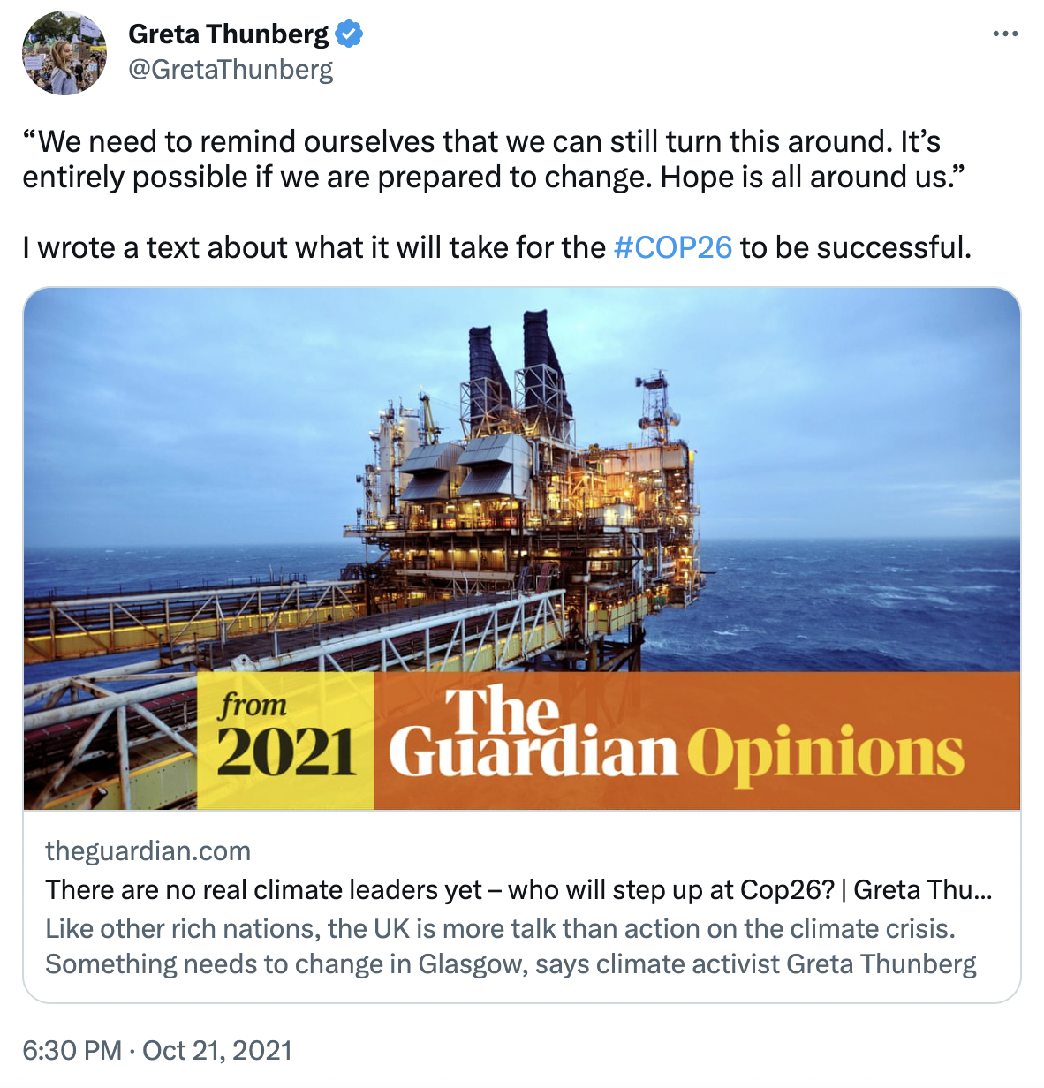

Data processing (example)
Timestamp: 2021-10-21 at 18:30
Stratification: Before COP26 (based on timestamp)
Actor: Greta Thunberg
Action: sharing of Trustworthy (T) news (NewsGuard score for theguardian.com is 100)

Slide 25
Time series creation

Slide 26
Influence graphs
Coupling Inference Methods

Slide 27
Key component: Coupling Inference Methods
Transfer Entropy (TE)
Joint Distance Distribution (JDD)
Need to binarize the time series
Naive estimation of state probabilities
Need an arbitrary threshold
Well-known and less subject to noise
Use original (standardized) values
Based on distances
Formulated as hypothesis testing
More subject to noise

Slide 28
Influence measures
Outdegree: for each node (actor) in the influence graph, outdegree directly indicates how many other actors this actor influenced.
D : Greta Thunberg
0
A : Bill Gates
B : Elon Musk
2
0
C : Brad Pitt
1

Slide 29
Influence measures
Outdegree: for each node (actor) in the influence graph, outdegree directly indicates how many other actors this actor influenced.
Betweenness: indication of how well one actor serves as a bridge to influence many other users.
D : Greta Thunberg
0
A : Bill Gates
B : Elon Musk
0
0
C : Brad Pitt
1

Slide 30
Influence measures
These measures can be fine-grained and derived for each edge type in the graph:
T-T: echo chamber of trustworthy news sharing.
T-U: credibility cross-over of trustworthy to untrustworthy news sharing
U-T: credibility cross-over of untrustworthy to trustworthy news sharing
U-U: echo chamber of untrustworthy news sharing.

Slide 31
Results

Slide 32
Action distributions
Proportion of untrustworthy news sharing larger during Skripal
May be a hint of underlying disinformation campaign
Skripal dataset
COP26 dataset
COP27 dataset
Notes:
TODO: put them at same scale

Slide 33
Comparison JDD-TE influence graphs
JDD detects large spikes of influence of the untrustworthy types during COP26.
No difference with the control for TE.
JDD on the COP26 dataset
TE on the COP26 dataset

Slide 34
One influence measure to rule them all?
Weak overall correlations
Only outdegree and betweenness exhibit relatively high correlation.
Each measure is in fact capturing different types of information, and influence definitions.
Correlation matrix between influence measures for JDD
on the COP26 dataset

Slide 35
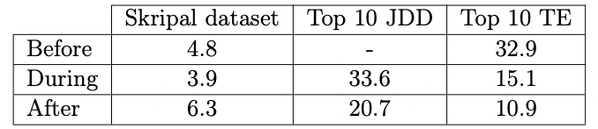
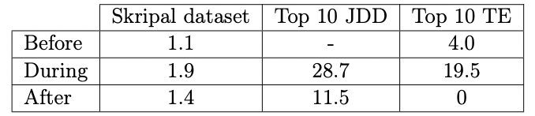
What do influential people share? -- Skripal
Mean number of mentions of “rt.com”
Mean number of mentions of “sputniknews.com”
RT and Sputnik vectors of Russian disinformation campaign during Skripal
Significantly more sharing of these websites by the most influential users we detected
Even more sharings by users detected by JDD compared to TE
Notes:
TODO: remove this slide?

Slide 36
What do influential people share? -- COP26
Most influential users share articles from China-controlled or far-right-affiliated media
JDD detects more content directly related to disinformation than TE
China-affiliated news outlets share anti-US and anti-Western climate narratives.
Far-right US outlets share counter narrative and narrative against Biden’s climate awareness

Slide 37
Conclusion

Slide 38
Conclusion
Derived and explored a novel method to measure influence and detect disinformation on social media.
Compared two coupling inference methods to derive the influence graphs.
Focused on climate change related data around the COP26 and COP27. Generalized on Skripal.
Influence measures have relatively low correlation between themselves, showcasing that they do not capture the same types of influence.
JDD results in sparser influence graphs, but finds individuals who seem more active in spreading disinformation than when using TE.

Slide 39
Future work
Explore other action definitions
Incorporate content analysis
Further validate on other known cases of disinformation campaigns

Slide 40
Thank you!

